Slide 1
Civility
for professional conversations

Slide 2
Executive Summary
The Problem
Contextual Interviews
Task Analysis
Application Ideas
Preliminary Design

Slide 3
Problem/Solution
Notes:
Problem: Emotions/morale in high-stress environment. Professionalism during conflicts
Solution: List of techniques talk about NLP

Slide 4
J.L.
Notes:
Participant: J.L. Relationship issue
Where: Bob Dining

Slide 5
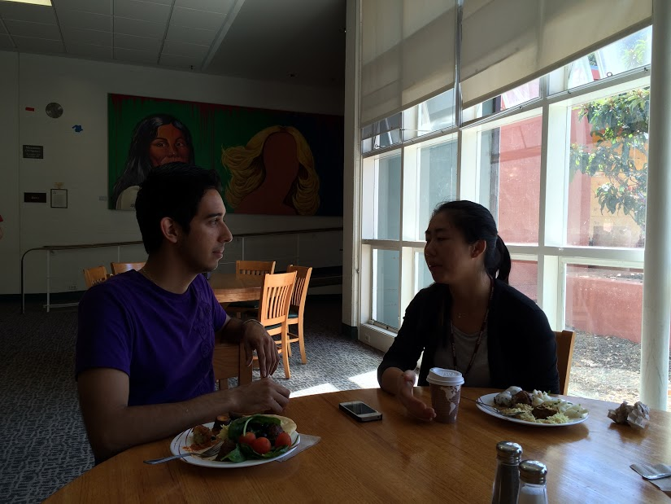
J.M.
Notes:
Participant: J.M. Resident Assistant
Location: Stern Dining

Slide 6
R.H.
Notes:
Participant: Pastor of local church and marriage counselor
Location: Phone interview

Slide 7
Task Analysis
Users
Current Tasks
Desired Tasks
Task Learning
Tasks Performed
Customer Data Relationship
Customer Tools
User Communication
Task Performance/Constraints
When Things Go Wrong

Slide 8
Users

Slide 9
Current Tasks

Slide 10
Desired Tasks

Slide 11
Task Learning

Slide 12
Feedback

Slide 13
Staying Calm

Slide 14
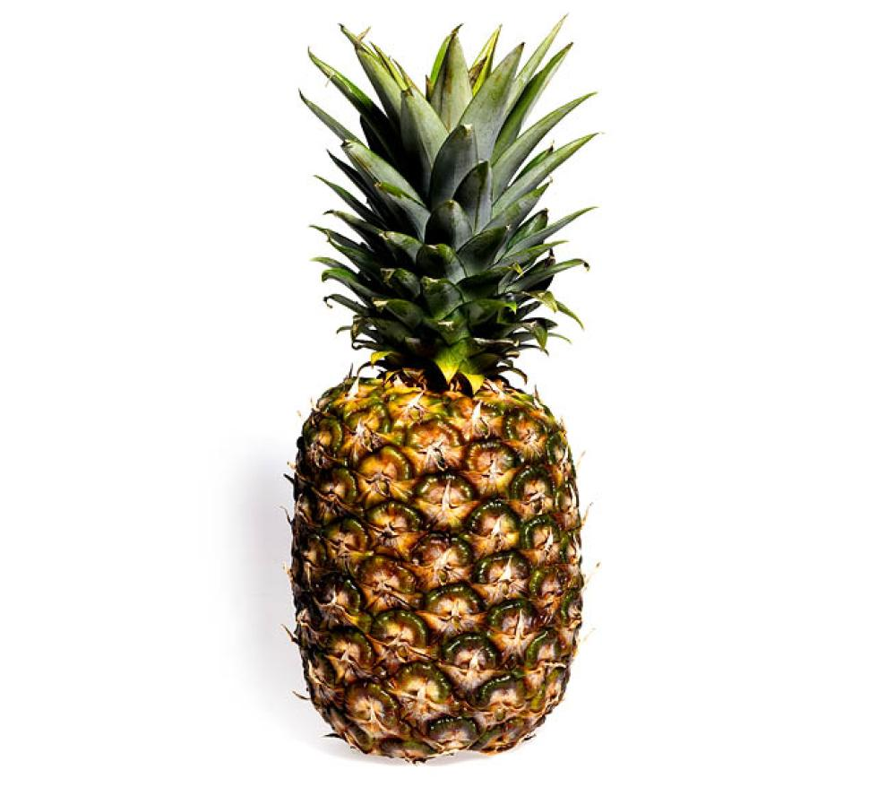
Identify Fruitless Conversation

Slide 15
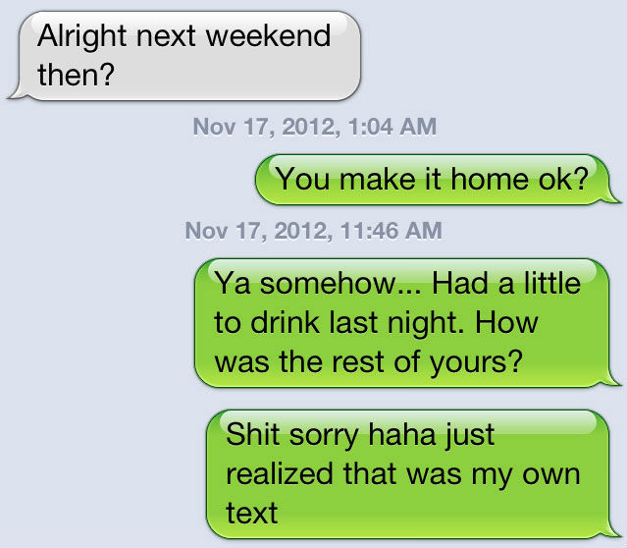
Intoxication Communication

Slide 16
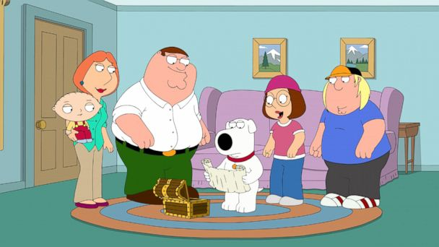
Family

Slide 17
Business

Slide 18
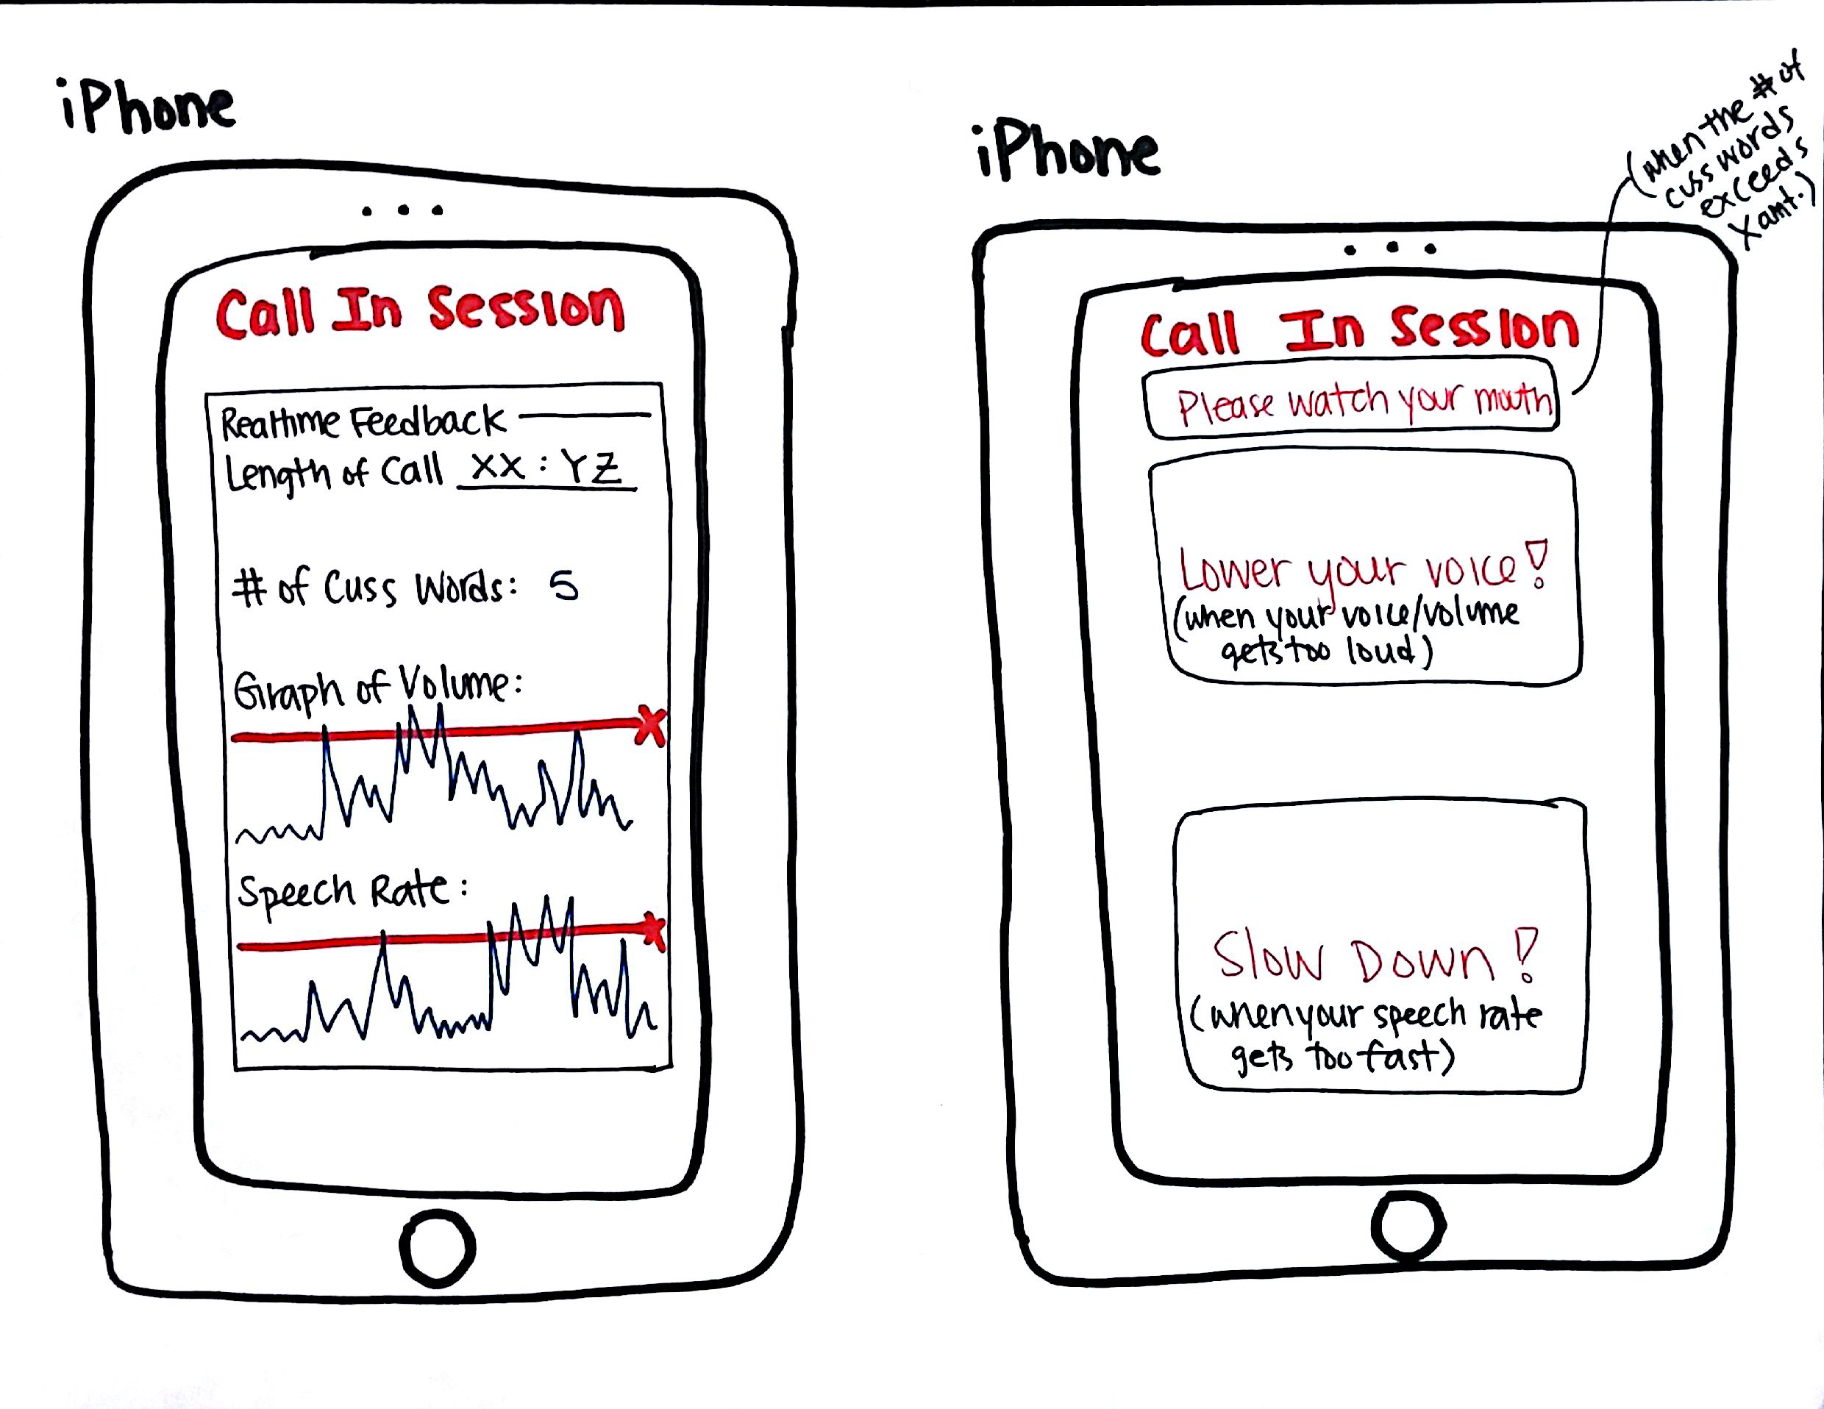
Phone Call

Slide 19
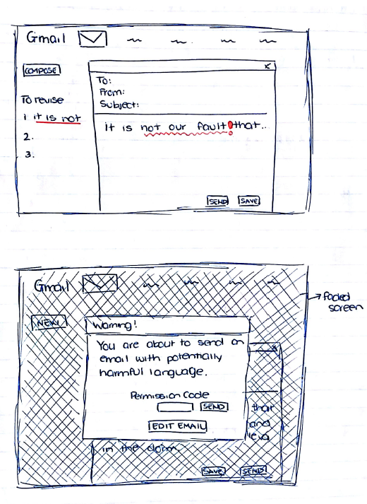
Email Check

Slide 20
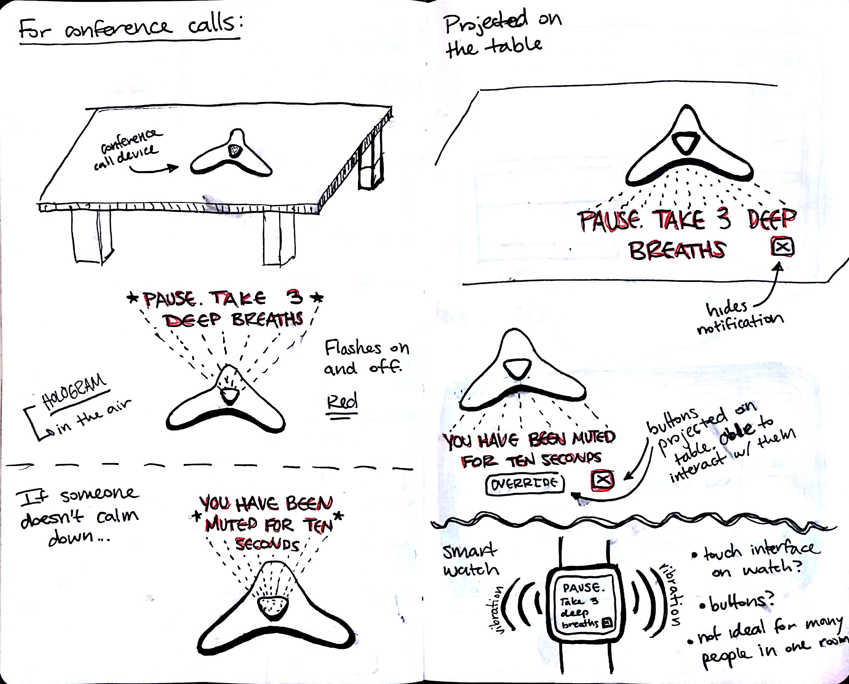
Conference

Slide 21
Summary
Outset
Application
Task Analysis
Designs
What We Want

